Slide 1
iMDE: international Market-Driven Engineering
Company visit 2
Supcon
(”control systems for industrial production”)

Slide 2
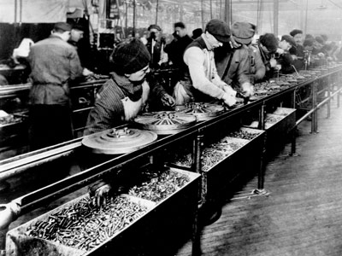
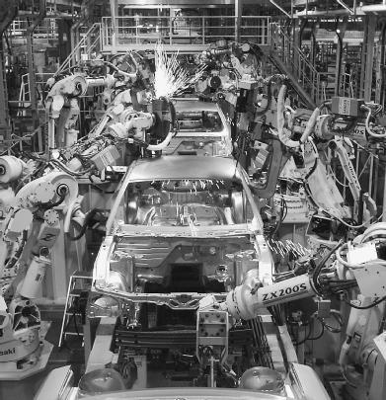
Production
1913
From: manual production
To: automated production
A journey of 100+ years
A journey filled with
many innovations
2010

Slide 3
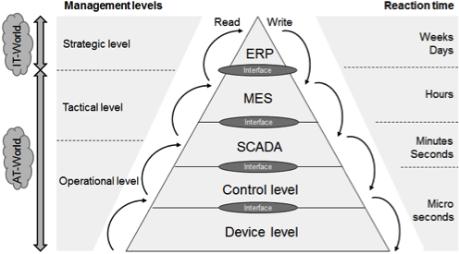
Production

Slide 4
Production
Hardware/Software Products
Enterprise
Resource Planning
Manufacturing
Execution Systems
DCS, PLC
SCADA
PID
controller
Motors,
pumps,
valve

Slide 5


About SUPCON
SUPCON Group Co., Ltd. (SUPCON in short)
Founded in 1993
A leading high-tech enterprise in China with focus on total solutions for innovative industrial control and information technologies.
Both hardware and software products
Customers: Steel, Chemical, Petrochemical, pulp and paper, Power, etc
Competitors: Siemens, ABB,
Rockwell Automation, Invensys,
GE Fanuc, Allan&Bradley, etc

Slide 6
About SUPCON
According to ARC Advisory Group's research, significant economic benefits can be obtained by applying process automation. For example, product quality can be increased by 19.2%, productivity by 13.5%, and production by 11.5%.
InPlant (note: Supcon’s solution) provides an integrated solution for process automation industries. The solution integrates process control, optimization, planning, scheduling and management.
More info: www.supcon.com

Slide 7
Visit to Supcon
Date: Wednesday October 10th, 2012.
Time: 08:00 – approx.13:00
Transport: Bus, we meet at Yuquan North gate at 08:00.
Schedule:
8:00am: Depart from Yuquan Campus
9:00am: Arrive at Supcon
9:00 – 10:15am: Introduction of the company
10:15 - 10.45 Presentation of the iMDE course for Supcon
10:45 - 11:30am: Discussion and presentation led by its employees
11:30am: Going back home
Each group to tell me (today) how many students that will join!
To Be Confirmed

Slide 8
Visit to Supcon
Date: Wednesday October 10th, 2012.
Time: 08:00 – approx.13:00
Transport: Bus, we meet at Yuquan North gate at 08:00.
Preparations:
Group 8: Prepare a presentation (30min) about the iMDE-course in English and Chinese.
Group 6: Prepare 5 questions about History and Start- up of Supcon (English and Chinese).
Group 2: Prepare 5 questions about Supcon and Innovations (English and Chinese).
Everyone to think of general questions

Slide 10
Other info
New Lecturehall Friday 12/10: Room 200 in West 1 Building on Xixi Campus (the first building on the left side when you enter the main gate of Xixi campus)
Each group to email me passfotos of the group members. I already have photos of the Swedish students.
Please reserv Wednesday evening (17/10) for a last joint course activity (informal). More info to come.
Swedish students: Tomorrow there will be a lecture about Chinese Calligraphy and painting. Students divided in 2 classes: Even groups in class 1. Odd groups in class 2

